Slide 1
Workforce Development Spotlight: August 2022 A Summary of Upcoming Career Compass and WFD Opportunities
New Content Coming Your Way!
Live Webinars Coming This Month
Making Tough Decisions (Decisiveness; Advanced/Expert) – 16 & 18 Aug
More details: http://www.navfac.navy.mil/Careers/Career-Compass-Workforce-Development/Career-Compass-Resource-Center/Competency-Development-Content/Decisiveness/
SYSCOM Training Opportunities
Please see the following page for additional opportunities. The Career Compass Event Calendar includes upcoming learning opportunities and trainings across the SYSCOM. More details: https://navfac.navy.mil/Careers/Career-Compass-Workforce-Development/Career-Compass-Resource-Center/Event-Calendar/
On-Demand Webinars and Resources Coming This Month
Decisiveness (early Aug):
On-Demand Webinar: Stop Doubting Your Skills at Work (Awareness/Basic)
Infographic: Dealing with Doubt (Awareness/Basic)
Podcast: Eliminating Doubt at Work (Awareness/Basic)
Job Aide: Overcoming Decision-Making Obstacles (Advanced/Expert)
Podcast: Stop Avoiding the Hard Decisions at Work (Advanced/Expert)
More details: http://www.navfac.navy.mil/Careers/Career-Compass-Workforce-Development/Career-Compass-Resource-Center/Competency-Development-Content/Decisiveness/
Intern Forums (early Aug):
On-Demand Webinar: Develop Yourself (Intern)
https://www.navfac.navy.mil/Careers/Career-Compass-Workforce-Development/Career-Compass-Resource-Center/Competency-Development-Content/Developing-Others/
On-Demand Webinar: Accountability (Intern)
https://www.navfac.navy.mil/Careers/Career-Compass-Workforce-Development/Career-Compass-Resource-Center/Competency-Development-Content/Accountability/
On-Demand Webinar: Problem Solving (Intern)
https://www.navfac.navy.mil/Careers/Career-Compass-Workforce-Development/Career-Compass-Resource-Center/Competency-Development-Content/Problem-Solving/
For additional details, please talk to your local Civilian Training Advocate (BD17).
*Note: If you are unable to copy and paste the links above, QR codes are available on the following page.

Slide 2
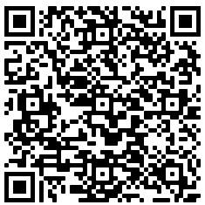
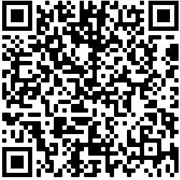
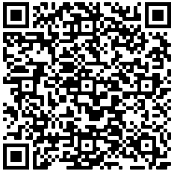
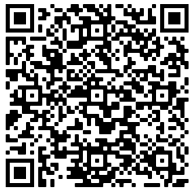
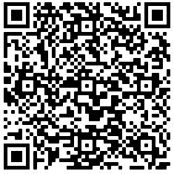
The QR codes below can be used to access the pages referenced in the previous slide.
August SYSCOM Training Summary
Start Date | Event
Mon, 08 Aug | Supervisor Academy: Current Supervisor Training II (East)
Tue, 16 Aug | Live Webinar: Making Tough Decisions
Thu, 18 Aug | Live Webinar: Making Tough Decisions
Mon, 22 Aug | Supervisor Academy: Current Supervisor Training II (West) Rescheduled
Tue, 30 Aug | Communicating for Results – Virtual Training (East)
Decisiveness Competency Page
Career Compass Event Calendar
Developing Others Competency Page
September Courses Open for Registration
Accountability
Competency Page
Start Date | Event | Registration Deadline
 | Additional SYSCOM trainings are planned for Sep and will be added as dates are available.
Problem Solving
Competency Page

